Slide 1
Beazley
GPAS & Billing Programme
Onboarding Pack
Draft: July 2024

Slide 2


Programme Background
  Beazley developed the Modernisation change programme to unlock existing barriers to growth by de-risking, simplifying, increasing efficiency and through better product distribution. The Modernisation programme is an ambitious multi-year programme, delivering value across Beazley’s functions & LOBs globally.
  GPAS (Global Policy Administration & Billing System) is a critical component of the Modernisation programme’s end to end architecture and will be provide a number of key commoditised capabilities to Beazley’s underwriting, billing and operations team globally including –
        Product Definition and Management
        System of record and transaction processing engine that will store quotes and bind and generate all policy transactions
        Enable policy servicing i.e. Mid Term Adjustment

Slide 3

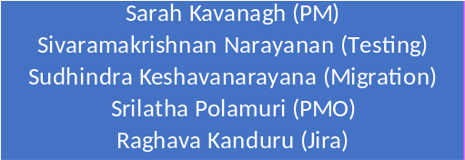
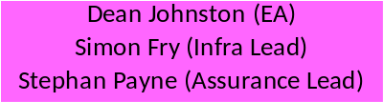
GPAS & Billing – ORG Chart
Executive sponsorship
Business sponsorship
Sr. Programme Lead
Delivery Leads
Governance
Governance
Product Rationalization
PolicyCenter
BillingCenter
Integration
Architecture
Sherezad Contractor
(Lead BA & Functional Lead)
Sriram Jagannathan (Lead BA & Functional Lead)
Gourab Marik (Functional Lead)
Kelly Reisling
(PR Lead)
Brett Fabian-Smith
Jigar Solanki
Rupesh Guttula
(Onshore BA)
Stuart Jerome
(Onshore BA)
Saurav Dhar & Akshit Anand
(BA)
Peter Dixon
(PR Lead)
Vamshi Chennamadhavuni
Ramesh Goundu
(Offshore Dev Lead)
Balaji KV & Ravi Prakash Tiwari
(On & Offshore Dev Lead)
Sahersh Gupta & Murali Bandaru
(On & Offshore Dev Lead)
Kesava Bhrugubanda
(PR Analyst)
Balaji Rajendran
TBD
(Test Lead)
TBD
(Test Lead)
TBD
(Test Lead)

Slide 4
VDI Request process
Identify the associate
RTL shares the associate data to CG PMO team to place the VDI creation request
CG PMO team updates the VDI sheet & maps the associate to respective persona based on the role
CG PMO team place the request to Beazley PMO team
Associate raise service request for Jira & Confluence access
Associates sends an email to Service.desk@beazley.com for temp password
Associates receives email with Login ID to CG inbox
(within 2W of request raise date)
Dev & Test associates receives email in Beazley inbox about disconnected machine details
Associates should setup & login to disconnected machine at least once in 2weeks to avoid decommission
*Beazley VDI resource details teams sharepoint location -
Beazley VDI details latest.xlsx

Slide 5
Policy Overview
Guidewire Policy Center application is used as a Policy Admin System to store and maintain the Beazley Policies
Implementing bunch of Speciality line Policies as part of Foundation Release
The new business will be captured by Pre Underwriting and Underwriting Workbench and stored in PC
Policy and Risk details will be captured in UWWB
Undewrting Issues will be handled in UWWB
UWWB consumes an External Rating Engine (GRS- Global Rating Services) used for Premium calculation.
Policy Quotes and versions will save in PC application once its quoted
Policy Amendments will be done from PC application
Renewals will be triggered from PC and processed in UWWB

Slide 6
Billing Overview
Guidewire Billing Center application is used as Billing Admin System. All Billing request coming from PolicyCenter is excuted and create corresponding accounts, policies, contacts, charges, Invoices and commission within BillingCenter to manage the financial life cycle of the policies
Create and manage invoice for Mult-year policies
Send applicable Payment Plans / Payment schedule to PolicyCenter on Quote
Managing and Calculating of commission and Refund Net of commission to Broker upon Policy Cancellation instructions received from PC
Settling of invoice according to Remittee and Bank Statement file and sending Payment details to Policy Center
Trigger and manage Delinquency workflow
Create, View and Manage Manual and Automatic Disbursements
Handle multicurrency payments
Manage invoicing and settlement for Inward Re-insurance
Send Billing data to MDA for Reporting
Create and manage Policy level Trouble Tickets
Create and Manage Billing Plan ,Payment Plan ,Delinquency Plan etc

Slide 7
Integrations Overview

Slide 8
Updated per Test Strategy doc
Testing Overview
In Scope
Out of Scope
•Functional testing of Guidewire PolicyCenter & BillingCenter which is configured as per the requirements finalized and documented in the product/ release backlog. The below scope might change based on the outcome of the architecture discussion which is in progress.
Policy life cycle transactions (Example - New Submission, Policy change, Cancellation, Renewal, Rewrite and Reinstatement etc.’)
Document triggers both out of the box and any customizations requested in requirements including the link to view the document
Business Rules- Underlying policy business rules (Underwriting, extension & renewal) and Billing business rules and finance operation as well.
Roles- Role based testing (Underwriting org structure feed)
Billing lifecycle (Example – Invoicing, Cash matching, Disbursement, Delinquency management, finance operations & co-insurance)
Batches in Policy Center & Billing Center.
•Integrations - Integrations with PAS / Billing through Integration Gateway and / or direct integrations from guidewire . Integrations between PC & BC through MDA For example: (Authentication, Billing & Delinquency) Refer full Integration list can be accessed here
•Test automation – Sprint level test automation aligning to overall test automation strategy.
•Product Rationalization –Product Model will be converted as ADL (Admin Data load) and this will be validated against the relevant user stories.
•Migration testing - Policy Migration of D&O product lines from Source (On-prem) to Guidewire cloud
•End to End Testing with components outside GPAS and Billing during Sprints
•Systems outside Guidewire - PolicyCenter & BillingCenter
•3rd party management. For example- Scheduling/Planning, agreeing contracts, managing defects etc.
•Documents Testing (DocVault)
•NFT, OAT and UAT. Refer (E2E Test strategy)
•Beazley legacy system & its corresponding integration testing
•Downstream Systems within the Modernization Program
•Any other components that are not part of In Scope

Slide 9
Teams work in 4-week Sprints with Key Events & Activities
D
Sprint Demo & Incremental Feature Demo
All user stories are demoed to Business SME for feedback and sign off. An incremental feature demo is done across sprints
Scrum of Scrums
C
Use the Scrum of Scrum platform to get help by highlight cross stream dependencies or other external factors impacting team’s progress
E
Retrospective
Team meeting to review the completed Sprint to capture learnings and agree plan of action for improvements in future sprints
Backlog refinement
For any potential missed commitments having an impact on overall Release plan, Continuous focus on Backlog to refinement is critical
Time-boxed
working
(4-week sprint)
Future Sprints
User Stories tagged to the Sprint and meeting Definition of Ready identified for planning
Sprint Planning & Kickoff
A
Daily
Plan what stories the team will develop in the sprint; the Team decides how much to pull and how they will achieve the goal
Working, tested solutions created based on the Sprint plan
B
Team Stand-up
Daily stand-up to improve coordination through a quick check-in on progress, agreeing action plans for the day and surfacing obstacles.

Slide 10
Sprint in action on a Timeline
Sp1 Elab completes
Sp2 - 4 weeks Elaboration begins
*Only Sp1 Elaboration is 3 weeks
Sp1 - 4 weeks Build begins
Week-3 |  |  |  |  | Week-1 |  |  |  |  | Week-2 |  |  |  |  | Week-3 |  |  |  |  | Week-4
Day-1 | Day-2 | Day-3 | Day-4 | Day-5 | Day-1 | Day-2 | Day-3 | Day-4 | Day-5 | Day-1 | Day-2 | Day-3 | Day-4 | Day-5 | Day-1 | Day-2 | Day-3 | Day-4 | Day-5 | Day-1 | Day-2 | Day-3 | Day-4 | Day-5
Sprint1 preparation, validate Sprint1 DoR
Sprint1 Planning
Start Sprint1 in JIRA
Test planning, review and signoff
Test design, execution and automation
Defect triaging and retesting
Regression, demo & Reporting
Incremental Feature Demos to be planned by Beazley Product Owner across sprints, not necessarily for each sprint.
Sp3 - 4 weeks Elaboration begins
Sp4 - Elaboration start
Sp2 - 4 weeks Build starts
Sp3 - Build starts
Week-1 |  |  |  |  | Week-2 |  |  |  |  | Week-3 |  |  |  |  | Week-4 |  |  |  |  | Week-1
Day-1 | Day-2 | Day-3 | Day-4 | Day-5 | Day-1 | Day-2 | Day-3 | Day-4 | Day-5 | Day-1 | Day-2 | Day-3 | Day-4 | Day-5 | Day-1 | Day-2 | Day-3 | Day-4 | Day-5 | Day-1 | Day-2 | Day-3 | Day-4 | Day-5
Validate Sprint1 DoD
Sprint2 planning
Start Sprint 2 in Jira
Optimisation levers:
User story pushed to dev pipeline when ready
Show and tell as soon as the user story is ready
Early visibility into sprint closure through Jira dashboards
Jira to be used as the Single source of Truth on story development progress
Testing dashboards for real time progress on test- execution and defect trends
Validate Sprint2 DoD
Sprint3 Sprint planning
Start Sprint3 in Jira
Sprint2 Retrospective
Sprint1 Closure report
Sprint1 Retrospective
Sprint2
Closure report

Slide 11
governance
The overall success of this engagement will be based on close collaboration between all parties, transparency and fact-based decision making. We will also use this Governance process to keep us all collectively honest and true to the Programme objectives.
Note: Under Review
Monthly
SteerCo
Supplier Review
Reporting
Programme Working Group
Decisions
GPAS Programme Management Update
Weekly
Technical Design Authority
Business Design Authority
Change Control Board
Dependency Review Forum
RAID Review
Daily
Agile – Daily Stand-up / Scrum of Scrums

Slide 12


PROPOSED Roles & Ceremonies MatriX
Roles & Ceremonies | Daily Standup (Release train) | Daily Scrum of Scrums (RT Leads) | Cap/BZ Joint Stand-up | Dependency Forum | PMO RAID Review | Supplier Review Meeting | Program Management update | Change Board | Business Design Authority | Technical Design Authority | Program Working Group | Steer Co
Business Sponsors /Delivery Exec |  |  |  |  |  |  |  |  | x |  |  | x
Programme Director |  | x | x | x | x | x | x | x | x |  | x | x
Delivery Leads |  | x | x | x | x | x | x | x | x | x | x | x
Product Owner | x | x |  | x | x | x | x | x | x |  |  | x
Functional Leads | x | x | x | x | x |  | x | x | x |  | X
Subject Matter Experts |  | x |  |  |  |  | x | x | x | x
Architects | x | x |  | x | x |  | x |  | x | x | x
Platform Owners |  | x |  | x | x | x | x | x | x | x |  | x
Technical Leads | x | x | x | x | x |  | x | x |  | x
Test Managers | x | x | x | x | x |  | x | x
Development Team | x |  |  |  |  |  | x
Product Rationalization Team | x | x |  | x | x |  | x |  | x | x |  | x
Procurement Team |  | x |  | x | x | x | x
DevOps Team | x | x |  | x | x |  | x |  |  | x
PMO Team |  | x |  |  | x | x | x |  |  |  | x

Slide 13

Escalation process
Executive Level:
Escalation Etiquette:
Other key stakeholders:
Business Sponsor
Delivery Executive
Account Executive
Escalations
Decisions / Actions
Escalations are done jointly from Capgemini and Beazley representatives from one level to Capgemini & Beazley representatives at the next level up.
Prior to escalation, representatives will work together to:
Agree what they agree on
Agree what they disagree on
Prepare for the escalation, making clear:
  The problem statement
  The options for resolution and their pros and cons
  The decision(s) and / or action(s) required
  The date required by
  The impact of doing nothing / missing the date
Finance modernisation
Underwriting & Servicing
Data Migration
Operations
Programme Director
Programme Director
Delivery Lead
Delivery Lead
Product Owner
Functional Lead
Project Team:
Business SMEs, Business Analysts, Architects, Engineers, UAT team etc.
Business Analysts, Architects, Designers, Engineers, QA / Testers, DevOps, Scrum Masters, Data Scientists

Slide 14

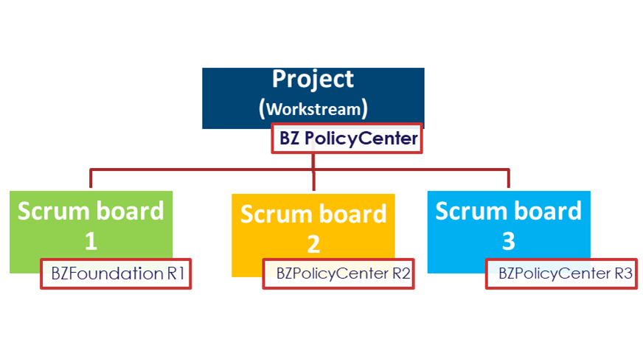
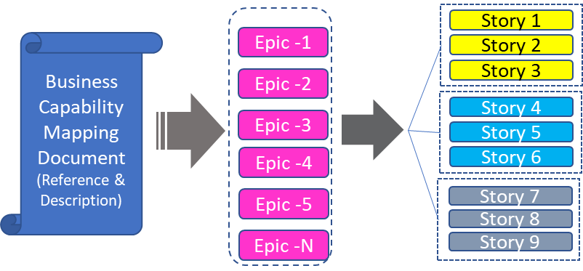
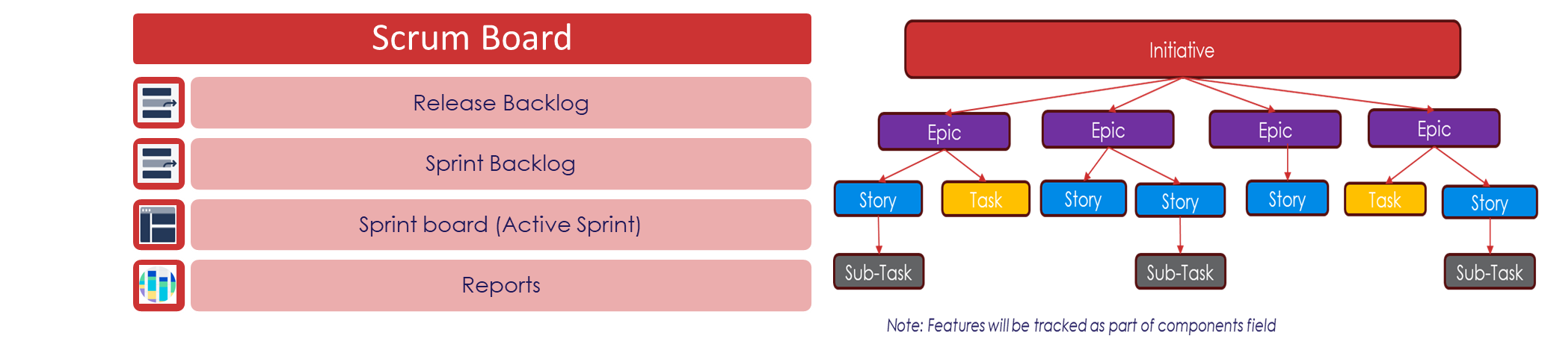
Jira Setup
Process to setup projects in Jira with one scheme configuration and upload prioritized backlog during inception phase
Step1 – Create one Schema Configuration for all GPAS projects
Step2 – Create Projects and set one scheme configuration
GPAS &Billing Projects
Screen Scheme
Workflow Scheme
Issue type Scheme
Permission Scheme
Step3 – Upload the prioritized backlog to GPAS projects

Slide 15
Useful links
D&O training video links –
https://capgemini-my.sharepoint.com/:b:/p/kiran_akula/ETQmEYsrlo5EqpjQIBZPMnAB_A0fDrBBimr9hH27zjEufA?e=vQkd0Q
https://capgemini-my.sharepoint.com/:b:/p/kiran_akula/EUx56tL5sN9NurigovxylwsBY5wjKCF22H-itan-KZ7qTA?e=EtBchB
Inception & Build Ways of Working
Beazley GPAS & Billing Ways of working-v1.2_BuildPhaseUpdates-BeingUpdated.pptx
Jira WOW
Beazley GPAS - Jira WOW - Draft.pptx
Training & Reference Material
Training and reading material
VDI Setup Issues
VDI Setup Issues.docx
Jira & Confluence Access Request Guide
Jira & confluence request guide.docx
Dependency Tracker
R1 Beazley MASTER Dependency Tracker v1.0.xlsx
Solution & Technical Documents
Solution & Technical Documents

Slide 16
Guidewire certification Overview
GW Certification status team’s location –
https://capgemini.sharepoint.com/:x:/r/sites/BeazleyJumpstart/Shared%20Documents/General/VDI/Beazley%20VDI%20details%20latest.xlsx?d=wddfb098cc6f540b2b2acf86c30ec14bf&csf=1&web=1&e=VsxYXX
Points to consider
  Trainings on D&O for new associates
  Certifications – 1: 4 to be maintained
    Leads should be ACE certified & rest should be Associate certified
    Integration criteria starting from March 2025
      Lead –> GW Credential – InsuranceSuite Cloud Integration

Slide 17
General Guidelines
Office -
Adhere to company attendance policies.
  Work from Office – 3 Days a week (Tuesday, Wednesday & Thursday)
Request time off in accordance with company policies. Provide adequate notice for vacation or sick leaves.
Teamwork & Collaboration
Work collaboratively with colleagues to achieve shared goals
Effective communication is key. Share information openly and honestly
Contribute to problem solving & finding solutions
Workplace Environment
Keep your workplace and common areas clean and tidy
Be mindful of noise levels.
Adhere to security protocols, such as locking doors

